Slide 1
[Plugin models]
Guide to connecting NVR Webviewer
14.JUN.2022

Slide 2
Title of document
Windows 10
Edge (IE mode)

Slide 3
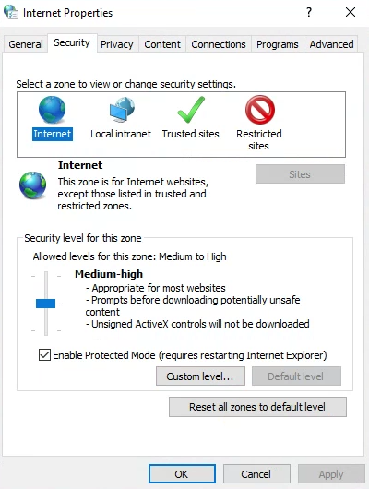
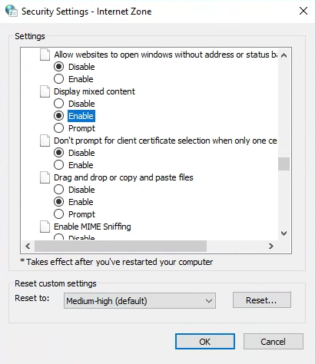
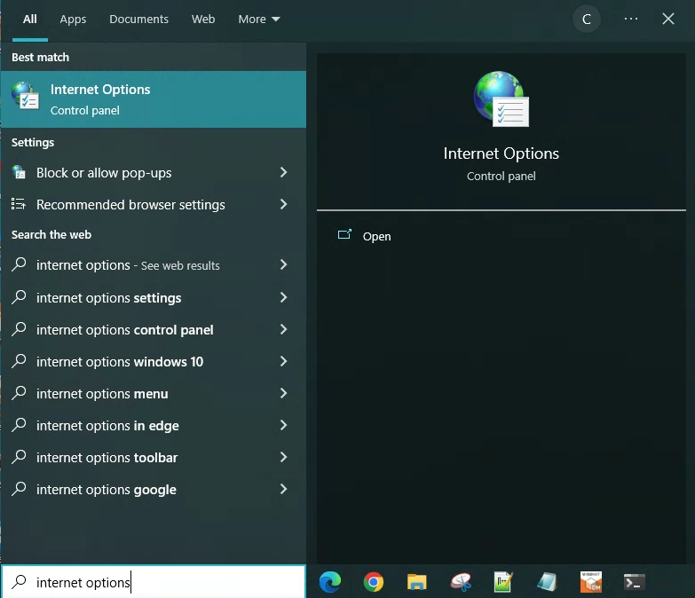
Set Internet Explorer Mode on Microsoft Edge(1)
[Step 1 – 2] Type “internet options” in the Cortana Search box and then clicks Internet Options.
[Step 3 – 4] Choose the Security tab, choose the Custom level.
[Step 5] Scroll down to the Display mixed content section and select the “Enable”.
[Step 6 – 7] Select OK in each of the option windows to close setting.
3
2
5
4
1
6
7

Slide 4
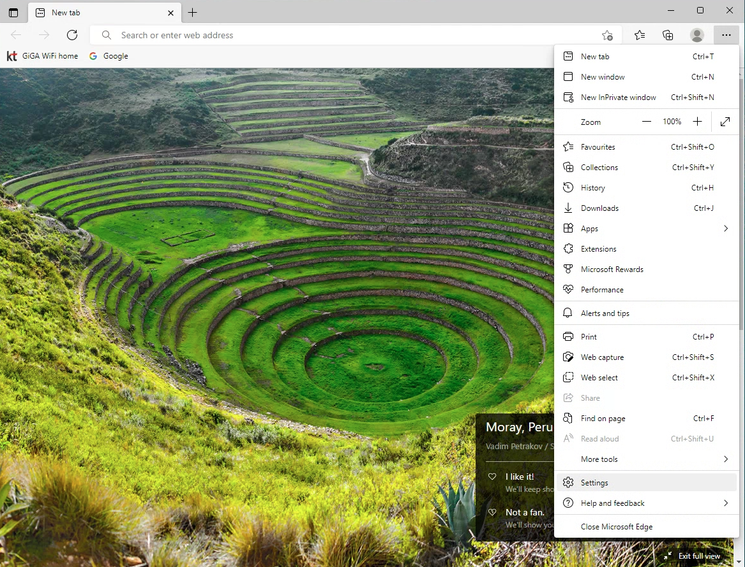
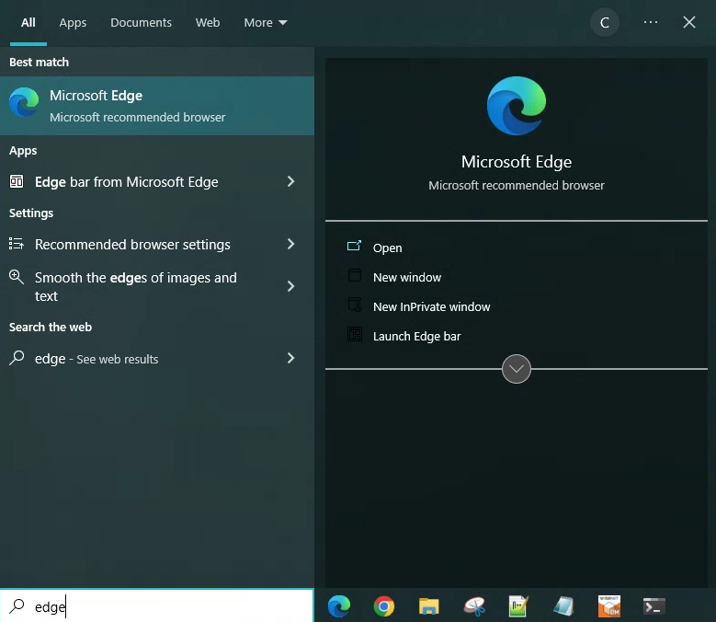
Set Internet Explorer Mode on Microsoft Edge(2)
[Step 1 – 2] Run Microsoft Edge(Type “edge” in the Cortana Search box and then clicks Microsoft Edge.)
[Step 3 – 4] Click the Settings and More (ellipsis) button on the top-right corner and then Select the Settings option.
3
2
4
1

Slide 5
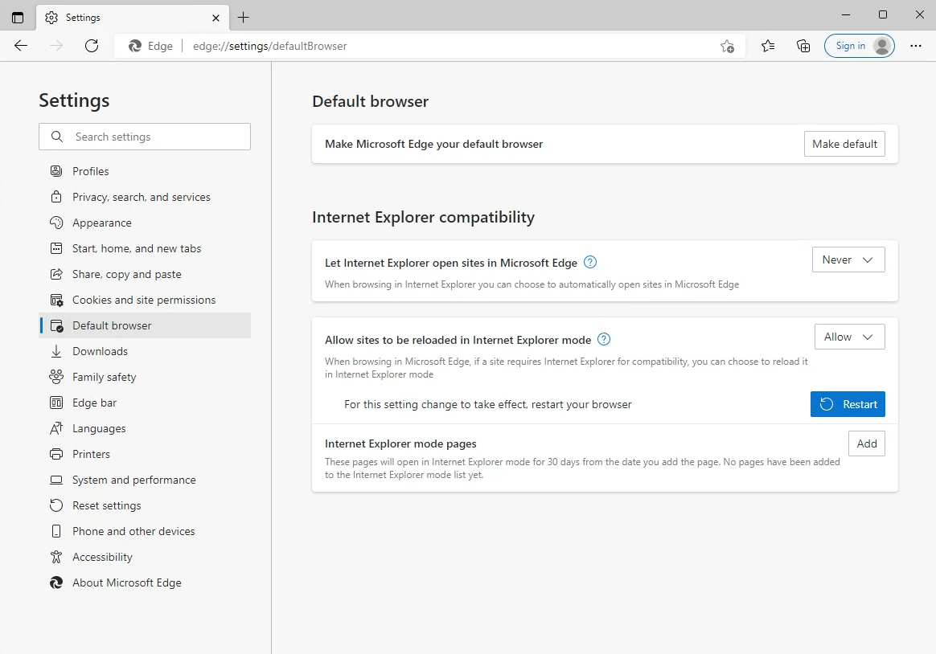
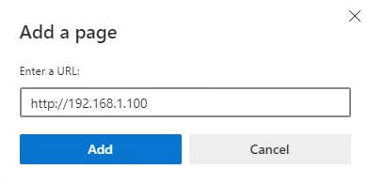
Set Internet Explorer Mode on Microsoft Edge(3)
[Step 1] Click on Default browser.
[Step 2] Under the “Internet Explorer compatibility” section, choose the Never on the “Let Internet Explorer open sites in Microsoft Edge”.
[Step 3] Choose the Allow on the “Allow sites to be reloaded in Internet Explorer mode”.
[Step 4 – 5] Add the NVR URL.
2
5
1
3
4

Slide 6
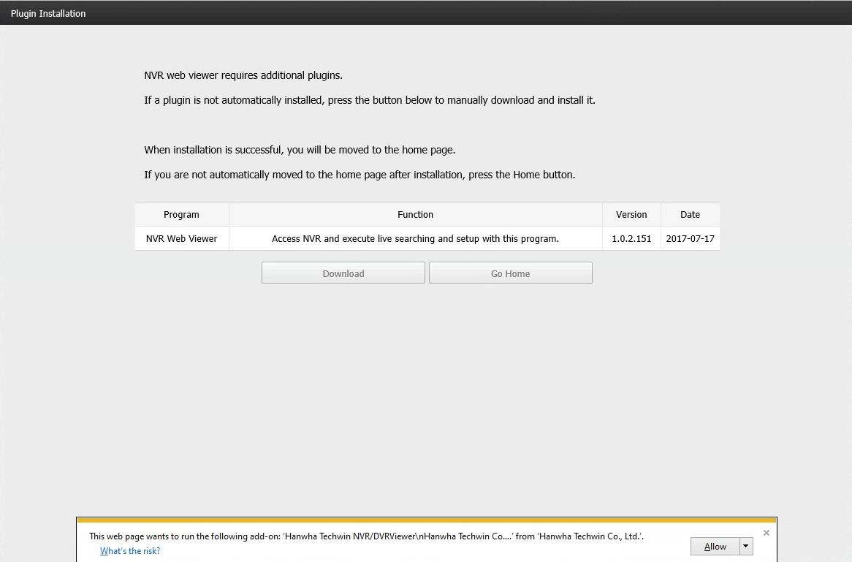
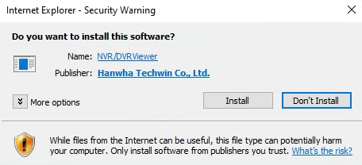
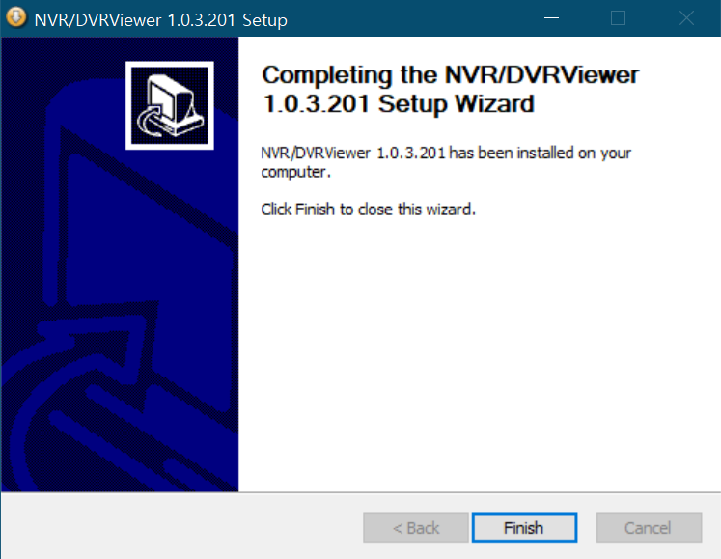
Connecting NVR Web Viewer
2
1
3

